Slide 1
Initiating Hospital Community Benefit Partnerships

Slide 2

Introductions
Kate Hill-Johnson, MA
Admin. Director of Community Health Improvement
Post-Acute Care and Compliance Division
Franciscan Health
Katharine.hill-johnson@franciscanalliance.org
(317) 294-5201 cell
(317) 528-3296 office

Slide 3
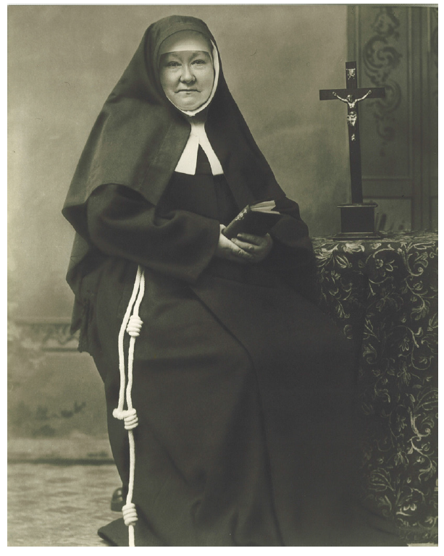
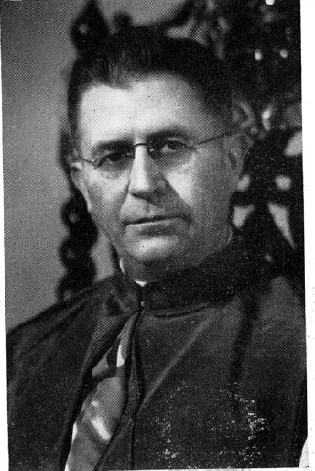
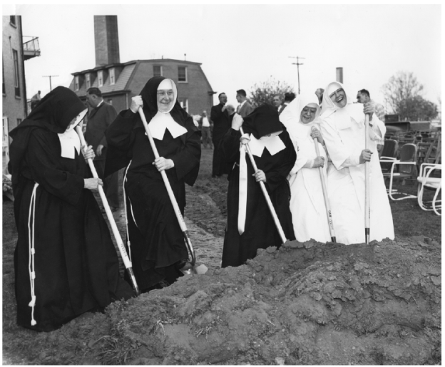
Franciscan Health

Slide 4

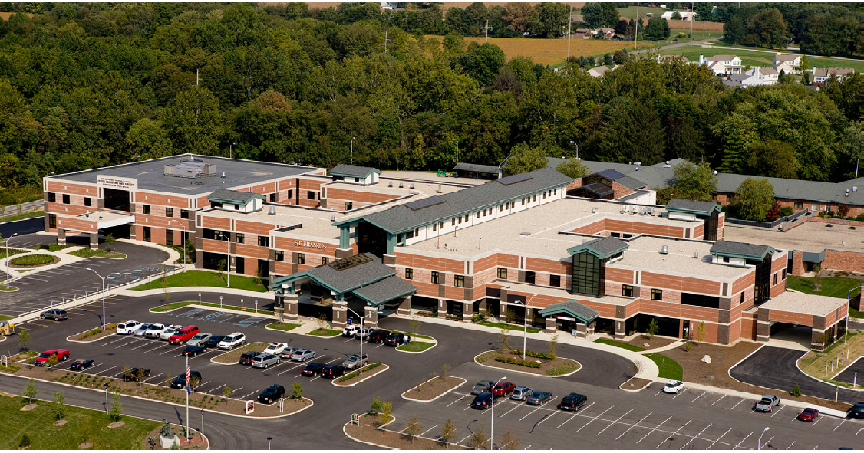
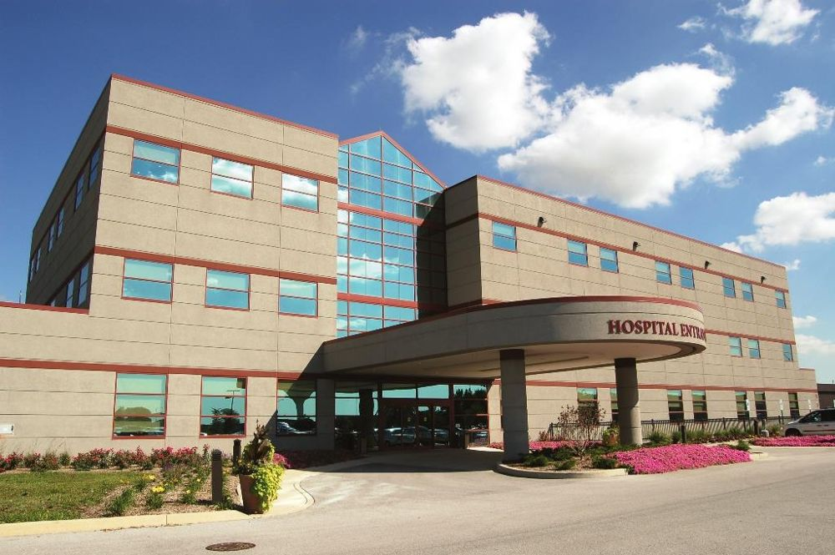
14 Hospitals Today*

Slide 5
Objectives
Define the community benefit regulation
Examine the components of a Community Health Needs Assessment (CHNA) and Community Health Improvement Plan
Explore opportunities to engage hospitals in community health work

Slide 6
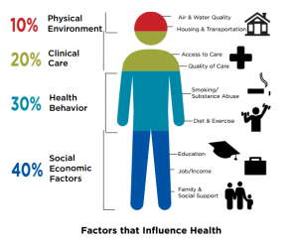
The IRS Regulation—Why?

Slide 7
Regulation Review
(Federal and Some States)
Community Health Needs Assessment (CHNA)
Community Health Improvement Plan (CHIP)
Annual reporting/tracking →I-990
Partnerships are vital, especially with public health agencies and healthy community coalitions
Evaluation and outcomes should be reported
All items publically available (accountability and transparency)
Consequences: Loss of non-profit status, fine of up to $50,000 per day

Slide 8
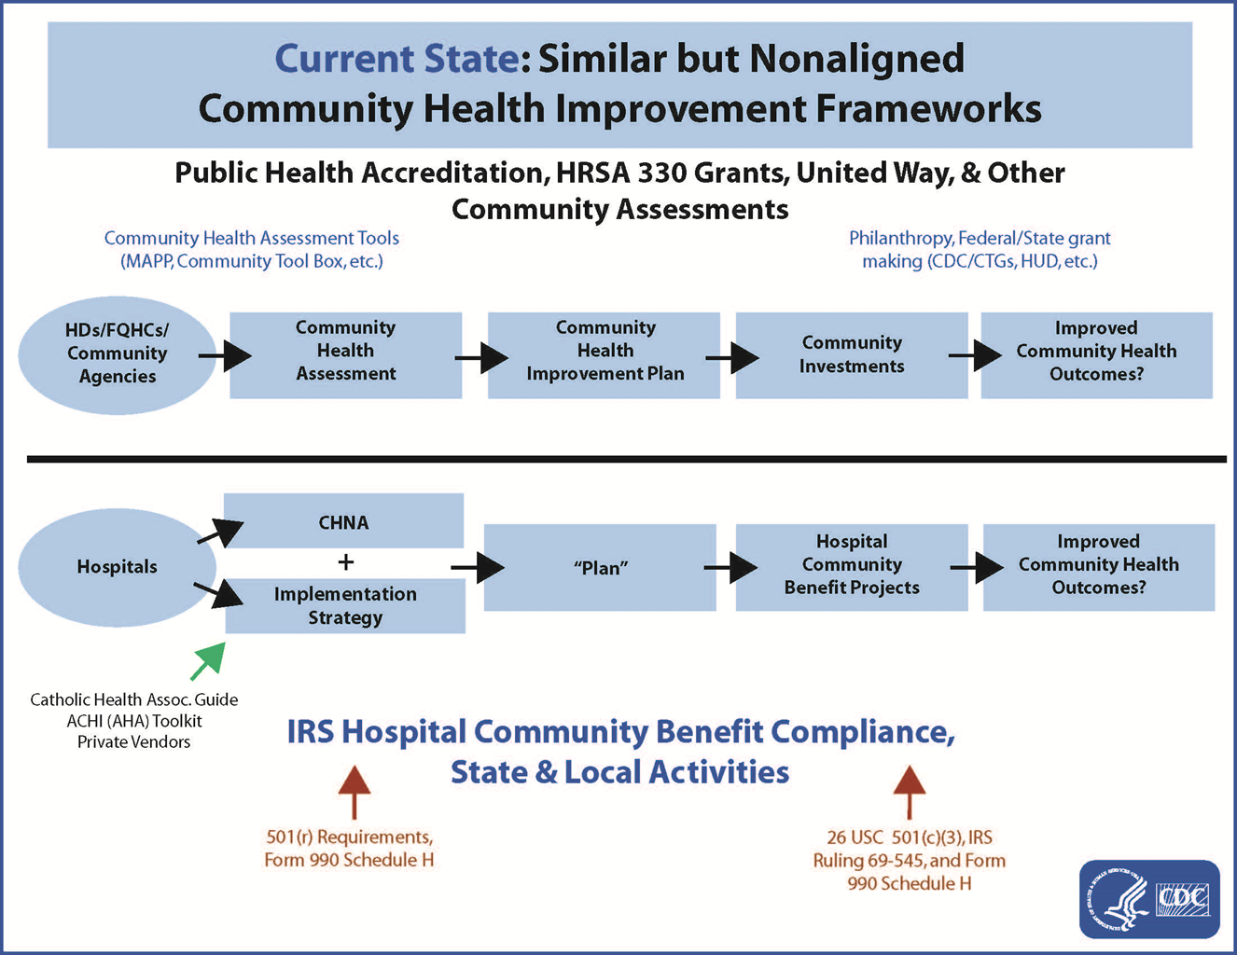

Slide 9
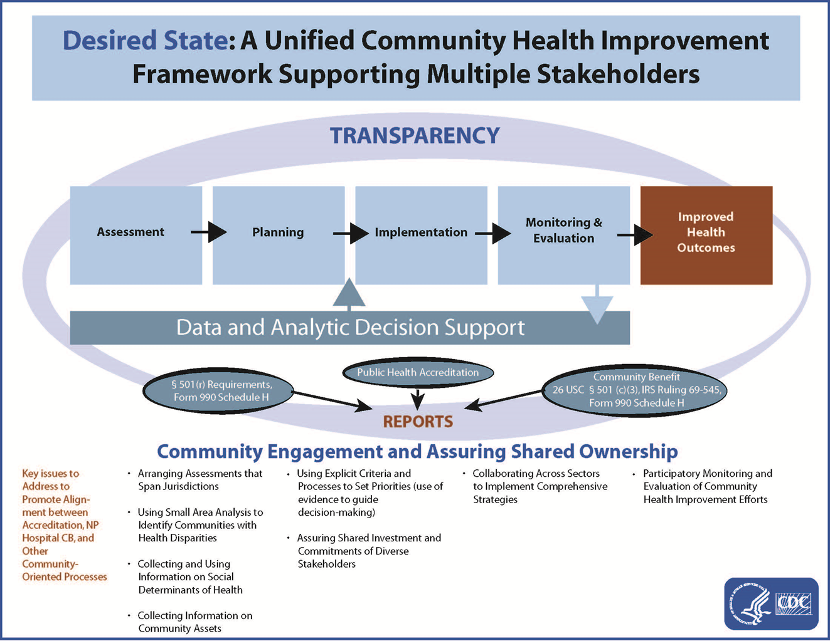

Slide 10
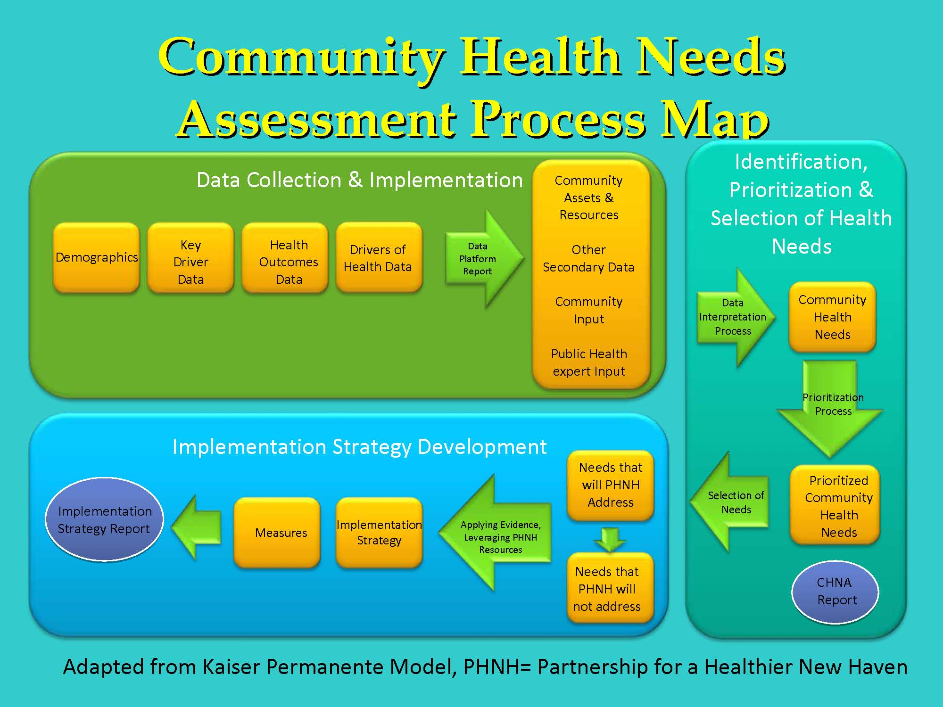

Slide 11
Community Health Needs Assessments
Hospitals must:
Define community
Gather public, stakeholder, and expert data
Not excluded populations for ease
Post reports publically
Identify location in 990
Include action plan (Community Health Improvement Plan)

Slide 12
What Types of Programs ‘Count’
Community benefits are programs or activities that promote health and healing in response to identified community needs and meet at least one of these community benefit objectives:
  Improve access to healthcare services. (Majority of funds)
  Enhance the health of the community. (6%)
  Advance medical or healthcare knowledge. (23% education, 15% research)
  Relieve or reduce the burden of government or other community efforts.

Slide 13
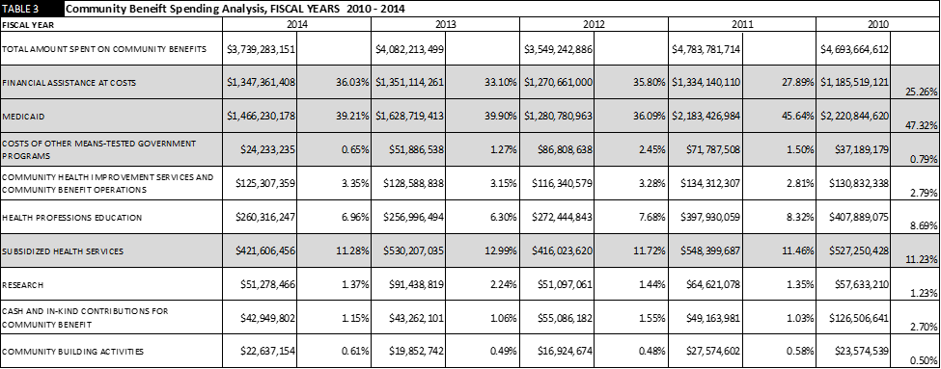

Slide 14
Catholic Health Association
Guiding Principles
Those who live at the margins of our society have a priority for services.
Not-for-profit health care has a responsibility to work toward improved health in the communities they serve.
Health care facilities should actively involve community members, organizations and agencies programs.
Health care organizations must demonstrate the value of their community service.
Community benefit programs must be integrated throughout the organization.
Leadership commitment is required for successful community benefit programs.

Slide 15
Community Benefit Issues
Lack of understanding of the public health system
Lack of knowledge in program planning, evaluation
Small allocated funds (3.5%-10%, 5% mean)
Unstable internal and external environments
Health care versus public health ‘languages’
Bad debt vs charitable care future
Research restrictions future
Scope of service (joint ventures, Accountable Care Organizations, etc)

Slide 16
How Do You Navigate Assessments?
Go to the hospital website for ‘CHNA,’ ‘CHIP,’ and reports
Look through report for name of staff or department (community benefit, community relations, community health, about us, marketing, outreach, mission, etc), priorities, key findings, partners, funding, and other information
Information on outside database sites are generally dated

Slide 17
Resources
2010-2014 partial tax data: http://communitybenefitinsight.org/
Information about community benefit and health: https://www.communitycatalyst.org/
Community benefit guidance: https://www.chausa.org/communitybenefit/community-benefit
Build your own assessment: https://www.communitycommons.org/

Slide 18
Summary
Define the community benefit regulation
Examine the components of a Community Health Needs Assessment (CHNA) and Community Health Improvement Plan
Explore opportunities to engage hospitals in community health work
Questions?

